Slide 1
Angular JS
A brief Introduction
Adekunle

Slide 2
What is AngularJS
MVC Javascript Framework by Google for Rich Web Application Development

Slide 3


Slide 4
Why AngularJS
“Other frameworks deal with HTML’s shortcomings by either abstracting away HTML, CSS, and/or JavaScript or by providing an imperative way for manipulating the DOM. Neither of these address the root problem that HTML was not designed for dynamic views”.
Structure, Quality and Organization
Lightweight ( < 36KB compressed and minified)
Free
Separation of concern
Modularity
Extensibility & Maintainability
Reusable Components
“ HTML? Build UI Declaratively! CSS? Animations! JavaScript? Use it the plain old way!”

Slide 5
jQuery
Allows for DOM Manipulation
Does not provide structure to your code
Does not allow for two way binding

Slide 6
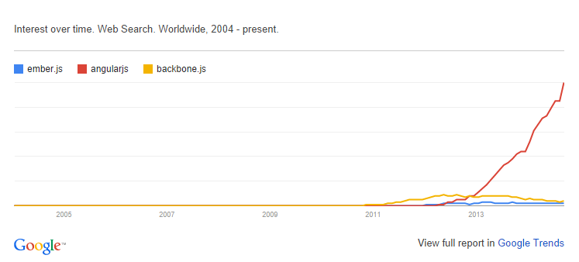
Other Javascript MV* Frameworks
BackboneJS
EmberJS

Slide 7
Features of AngularJS
Two-way Data Binding – Model as single source of truth
Directives – Extend HTML
MVC
Dependency Injection
Testing
Deep Linking (Map URL to route Definition)
Server-Side Communication

Slide 8
Data Binding
<html ng-app>
<head>
<script src='angular.js'></script>
</head>
<body>
<input ng-model='user.name'>
<div ng-show='user.name'>Hi {{user.name}}</div>
</body>
</html>

Slide 9
MVC
Model (Data)
View (UI)
Notifies
Notifies
Changes
Controller (Logic)

Slide 10
MVC
Model
JS Objects
View
DOM
Controller
JS Classes

Slide 11
MVC
<html ng-app>
<head>
<script src='angular.js'></script>
<script src='controllers.js'></script>
</head>
<body ng-controller='UserController'>
<div>Hi {{user.name}}</div>
</body>
</html>
function XXXX($scope) {
$scope.user = { name:'Larry' };
}

Slide 12
Hello HTML
<p>Hello World!</p>

Slide 13
Hello Javascript
<p id="greeting1"></p>
<script>
var isIE = document.attachEvent;
var addListener = isIE
? function(e, t, fn) {
e.attachEvent('on' + t, fn);}
: function(e, t, fn) {
e.addEventListener(t, fn, false);};
addListener(document, 'load', function(){
var greeting = document.getElementById('greeting1');
if (isIE) {
greeting.innerText = 'Hello World!';
} else {
greeting.textContent = 'Hello World!';
}
});
</script>

Slide 14
Hello JQuery
<p id="greeting2"></p>
<script>
$(function(){
$('#greeting2').text('Hello World!');
});
</script>

Slide 15
Hello AngularJS
<p ng:init="greeting = 'Hello World!'">{{greeting}}</p>

Slide 16
DEMONSTRATION!!!!!
Feeder App
http://www.toptal.com/angular-js/a-step-by-step-guide-to-your-first-angularjs-app

Slide 17
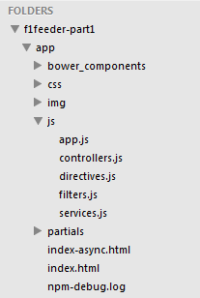
App Skeleton

Slide 18
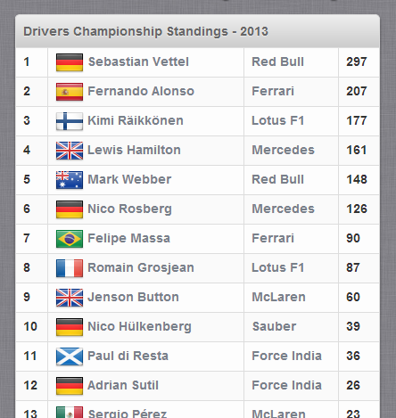
Final View (Championship Table)

Slide 19
Sample Angular Powered View
<body ng-app="F1FeederApp" ng-controller="driversController">
<table>
<thead>
<tr><th colspan="4">Drivers Championship Standings</th></tr>
</thead>
<tbody>
<tr ng-repeat="driver in driversList">
<td>{{$index + 1}}</td>
<td>
<img src="img/flags/{{driver.Driver.nationality}}.png" />
{{driver.Driver.givenName}}&nbsp;{{driver.Driver.familyName}}
</td>
<td>{{driver.Constructors[0].name}}</td>
<td>{{driver.points}}</td>
</tr>
</tbody>
</table>
</body>

Slide 20
Expressions
Expressions allow you to execute some computation in order to return a desired value.
{{ 1 + 1 }}
{{ 946757880 | date }}
{{ user.name }}
you shouldn’t use expressions to implement any higher-level logic.

Slide 21
Directives
Directives are markers (such as attributes, tags, and class names) that tell AngularJS to attach a given behaviour to a DOM element (or transform it, replace it, etc.)
Some angular directives
The ng-app - Bootstrapping your app and defining its scope.
The ng-controller - defines which controller will be in charge of your view.
The ng-repeat - Allows for looping through collections

Slide 22
Directives as Components
<rating max='5' model='stars.average'>
<tabs>
<tab title='Active tab' view='...'>
<tab title='Inactive tab' view='...'>
</tabs>
<tooltip content='messages.tip1'>

Slide 23
Adding Controllers
angular.module('F1FeederApp.controllers', []).
controller('driversController', function($scope) {
$scope.driversList = [
{
Driver: {
givenName: 'Sebastian',
familyName: 'Vettel'
},
points: 322,
nationality: "German",
Constructors: [
{name: "Red Bull"}
]
},
{
Driver: {
givenName: 'Fernando',
familyName: 'Alonso'
},
points: 207,
nationality: "Spanish",
Constructors: [
{name: "Ferrari"}
]
}
];
});
The $scope variable – Link your controllers and view

Slide 24
App.js
angular.module('F1FeederApp', [
'F1FeederApp.controllers'
]);
Initializes our app and register the modules on which it depends

Slide 25
Index.html
<body ng-app="F1FeederApp" ng-controller="driversController">
<table>
<thead>
<tr><th colspan="4">Drivers Championship Standings</th></tr>
</thead>
<tbody>
<tr ng-repeat="driver in driversList">
<td>{{$index + 1}}</td>
<td>
<img src="img/flags/{{driver.Driver.nationality}}.png" />
{{driver.Driver.givenName}}&nbsp;{{driver.Driver.familyName}}
</td>
<td>{{driver.Constructors[0].name}}</td>
<td>{{driver.points}}</td>
</tr>
</tbody>
</table>
<script src="bower_components/angular/angular.js"></script>
<script src="bower_components/angular-route/angular-route.js"></script>
<script src="js/app.js"></script>
<script src="js/services.js"></script>
<script src="js/controllers.js"></script>
</body>
</html>

Slide 26
Loading data from the server(services.js)
angular.module('F1FeederApp.services', []).
factory('ergastAPIservice', function($http) {
var ergastAPI = {};
ergastAPI.getDrivers = function() {
return $http({
method: 'JSONP',
url: 'http://ergast.com/api/f1/2013/driverStandings.json?callback=JSON_CALLBACK'
});
}
return ergastAPI;
});
$http - a layer on top of XMLHttpRequest or JSONP
$resource - provides a higher level of abstraction
Dependency Injection
we create a new module (F1FeederApp.services) and register a service within that module (ergastAPIservice).

Slide 27
Modified controller.js
angular.module('F1FeederApp.controllers', []).
controller('driversController', function($scope, ergastAPIservice) {
$scope.nameFilter = null;
$scope.driversList = [];
ergastAPIservice.getDrivers().success(function (response) {
//Dig into the responde to get the relevant data
$scope.driversList = response.MRData.StandingsTable.StandingsLists[0].DriverStandings;
});
});

Slide 28
Routes
$routeProvider – used for dealing with routes
Modified app.js
angular.module('F1FeederApp', [
'F1FeederApp.services',
'F1FeederApp.controllers',
'ngRoute'
]).
config(['$routeProvider', function($routeProvider) {
$routeProvider.
when("/drivers", {templateUrl: "partials/drivers.html", controller: "driversController"}).
when("/drivers/:id", {templateUrl: "partials/driver.html", controller: "driverController"}).
otherwise({redirectTo: '/drivers'});
}]);

Slide 29
Partial views
<!DOCTYPE html>
<html>
<head>
<title>F-1 Feeder</title>
</head>
<body ng-app="F1FeederApp">
<ng-view></ng-view>
<script src="bower_components/angular/angular.js"></script>
<script src="bower_components/angular-route/angular-route.js"></script>
<script src="js/app.js"></script>
<script src="js/services.js"></script>
<script src="js/controllers.js"></script>
</body>
</html>

Slide 30
Advanced AngularJS Concept
Dependency Injection
Modularity
Digesting
Scope
Handling SEO
End to End Testing
Promises
Localization
Filters

Slide 31
Useful Links
https://angularjs.org/
http://campus.codeschool.com/courses/shaping-up-with-angular-js/contents
http://www.toptal.com/angular-js/a-step-by-step-guide-to-your-first-angularjs-app
https://github.com/raonibr/f1feeder-part1

